Slide 1
Unit 4 :
Performing simple queries
Session 1
Databases
1

Slide 2
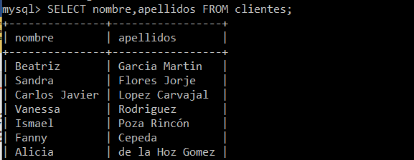
The SELECT statement
The SQL statement to query data stored in database tables is SELECT. It is normally the instruction most used by database users.
When SELECT is executed, if the statement has no errors, the DBMS returns a results sheet that is displayed in the form of a table in the client we are using.
2

Slide 3
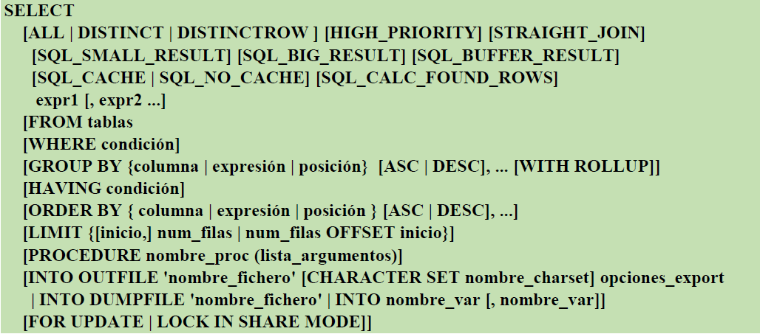
The SELECT statement
Full SELECT syntax:
Detail information at: https://dev.mysql.com/doc/refman/8.0/en/select.html
3

Slide 4
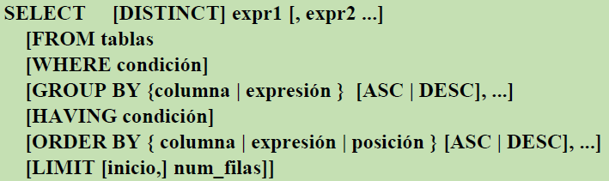
The SELECT statement
SELECT main syntax:
4

Slide 5
The SELECT statement
Description of the main syntax of SELECT:
Between SELECT and FROM, the columns or expressions you want to consult are written separated by commas. Data that does not belong in tables, such as that returned by a function, can be queried.
DISTINCT allows rows of identical results not to be repeated.
FROM allows you to indicate the table or tables from which the data is extracted.
WHERE allows you to select the rows from which data is extracted, and set conditions on what you want to consult.
GROUP BY allows you to group rows that have equal values in one or more columns so that they appear in a single row.
HAVING allows you to establish conditions on data obtained from groupings.
ORDER BY allows you to sort the results sheet by a column, by several columns or by an expression.
LIMIT allows you to indicate that only a maximum number of rows returned by a SELECT are displayed.
5

Slide 6
The SELECT statement
queries without FROM. Examples
Get the current date and time .
SELECT curdate (), curtime ();
Obtain he result of division between 7 and 2 and the result of the quotient and remainder of its division .
SELECT 7/2, 7 div 2, 7 mod 2;
Obtain he current user and MySQL Server version .
SELECT current_user (),version();
6

Slide 7
The SELECT statement
Operators in SELECT queries
As we have seen in the previous slide, operators can be used in expressions written in SELECT. They can also be used in other instructions.
Arithmetic operators:
operator +, is used to add two numbers and, as a unary operator, to symbolize the positive sign of a number.
- operator, is used to find the difference between two numbers and, as a unary operator, to symbolize the negative sign of a number.
operator *, used to multiply two numbers.
operator / , is used to divide two numbers and obtain a floating point result.
div operator, is used to divide two numbers and the resulting quotient in the form of an integer (integer division) integer.
% or mod operators divide two numbers and return the integer remainder of the division.
7

Slide 8
The SELECT statement
Operators in SELECT queries
Comparison or relational operators:
operator , compares if equal
operator > , compares if greater
operator , compares if less
operator <= , compares if less than or equal
operator >= , compares if greater than or equal
operator , compares if different
Logical operators:
Operator | Function
AND | Applies between two expressions conditionals (or booleans ) and returns the value TRUE when both conditions are true
OR | Applies between two conditional expressions and returns the value FALSE when both conditions are false
NOT | Applies to an expression conditional and returns the opposite of the condition following NOT
8

Slide 9
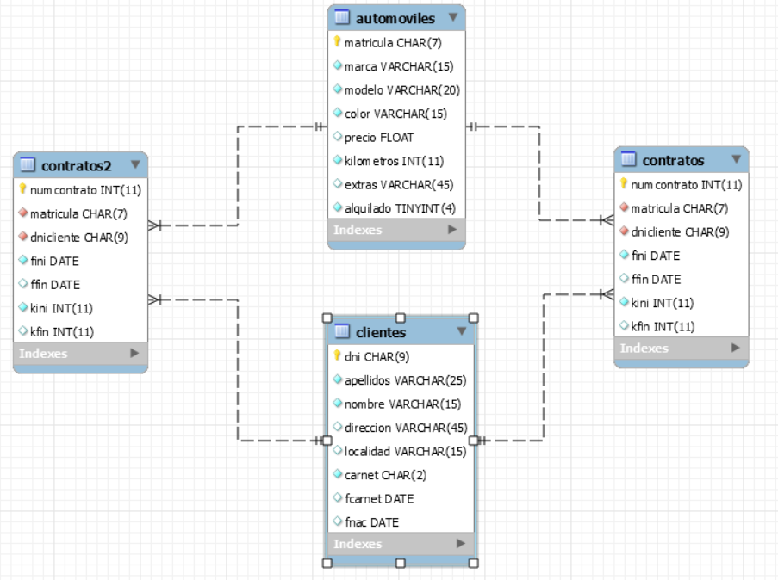
The SELECT statement
RENTALS database that we are going to use in all the examples of this unit:
9

Slide 10
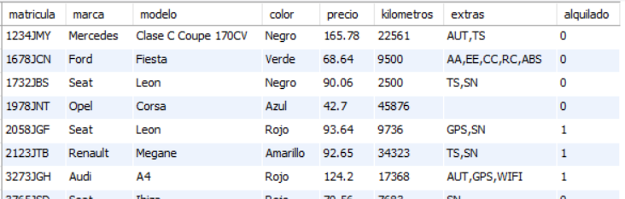
The SELECT statement
Consult all rows in a table
When SELECT is executed without the WHERE clause , all rows in the table .
To get all data in the table ( all columns ) you can use the wildcard * , unless we want the columns to be obtained in order different from the table layout .
Example : Get all data in the table automobiles .
SELECT * FROM cars ;
10

Slide 11
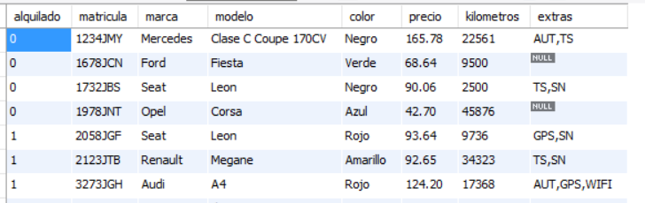
The SELECT statement
Consult all rows in a table
When we want obtain some columns and/or expressions you will have to write them separated by commas.
Example : Get all data in the table automobiles representing as first column , the column rented .
SELECT rented , registration, make , model , color, price , kilometers , extras FROM cars ;
11

Slide 12
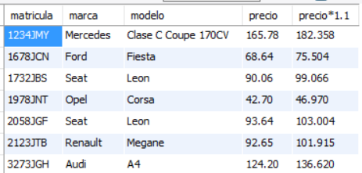
The SELECT statement
Consult all rows in a table
When we want obtain some columns and/or expressions you will have to write them separated by commas.
Example : Obtain the license plates, makes and models of all the cars along with the price and the price increased by 10%.
SELECT registration, make , model , price , price *1.1 FROM automobiles ;
12

Slide 13
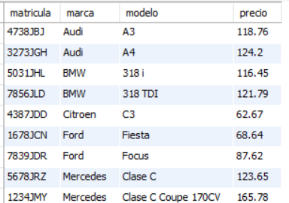
The SELECT statement
Order results : To sort the results sheet by one or more expressions , the clause is used ORDER BY expr1, … [ASC|DESC]
Example : Obtain registration , make , model and rental price of all cars _ organized ascending by brand and how second criterion by model .
SELECT registration, make , model , price FROM automobiles ORDER BY make , model ;
13

Slide 14
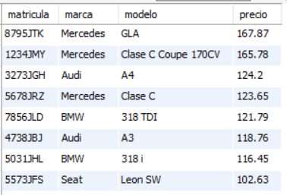
The SELECT statement
Order results ;
Example 5 Obtain registration , make , model and price of all cars Sorted by rental price from highest to lowest .
SELECT license plate, make , model , price FROM automobiles ORDER BY price DESC;
14

Slide 15
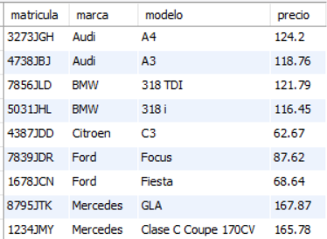
The SELECT statement
Sort results;
Example: Obtain registration, make, model and price of all cars ordered by brand ascending and then by rental price from highest to lowest.
SELECT license plate, make , model , price FROM automobiles ORDER BY make , price DESC;
15

Slide 16

The SELECT statement
No repeat rows with the same contents : So that they are not repeated on the results sheet rows exactly equals, the DISTINCT clause is used .
Example : Show the colors of all cars ( they can appear repeated ).
SELECT color FROM cars ;
Example : Show colors _ cars available . _
SELECT DISTINCT color FROM cars ;
16

Slide 17
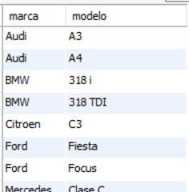
The SELECT statement
No repeat rows with the same contents :
Example : Obtain the brands and models available Sorted by brand and then by model .
SELECT DISTINCT make,model FROM automobiles ORDER BY make,model ;
17

Slide 18
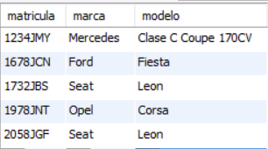
The SELECT statement
Limit he number of rows shown on the results sheet .
The clause LIMIT of the SELECT statement allows limit he number of rows in the results sheet . The syntax of the LIMIT clause within SELECT is:
LIMIT [ start ,] numrows
Example : Obtain the license plate , make and model of the first 5 cars that are registered In the table automobiles .
SELECT license plate, make, model FROM automobiles LIMIT 5;
18

Slide 19
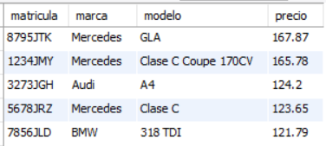
The SELECT statement
Limit he number of rows shown on the results sheet .
Example : Obtain the license plate , make , model and price of the 5 rental price cars higher .
SELECT license plate, make, model, price FROM automobiles ORDER BY price DESC LIMIT 5;
19

Slide 20
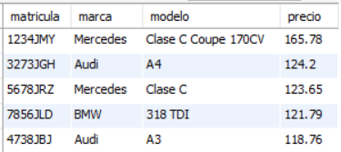
The SELECT statement
Limit the number of rows displayed on the results sheet.
Example: Obtain the license plate, make, model and price of the 5 cars with the highest rental price except for the most expensive.
SELECT license plate, make, model, price FROM automobiles ORDER BY price DESC LIMIT 1.5;
20

Slide 21

The SELECT statement
Limit the number of rows displayed on the results sheet.
Example: Obtain the name, surname and date of birth of the youngest client.
SELECT first name, last name FROM clients ORDER BY fnac DESC LIMIT 1;
21

